Slide 1
Mini project
on
Furniture Sales prediction
Presented by:-
Channappa Momdi
Dsft-8

Slide 2

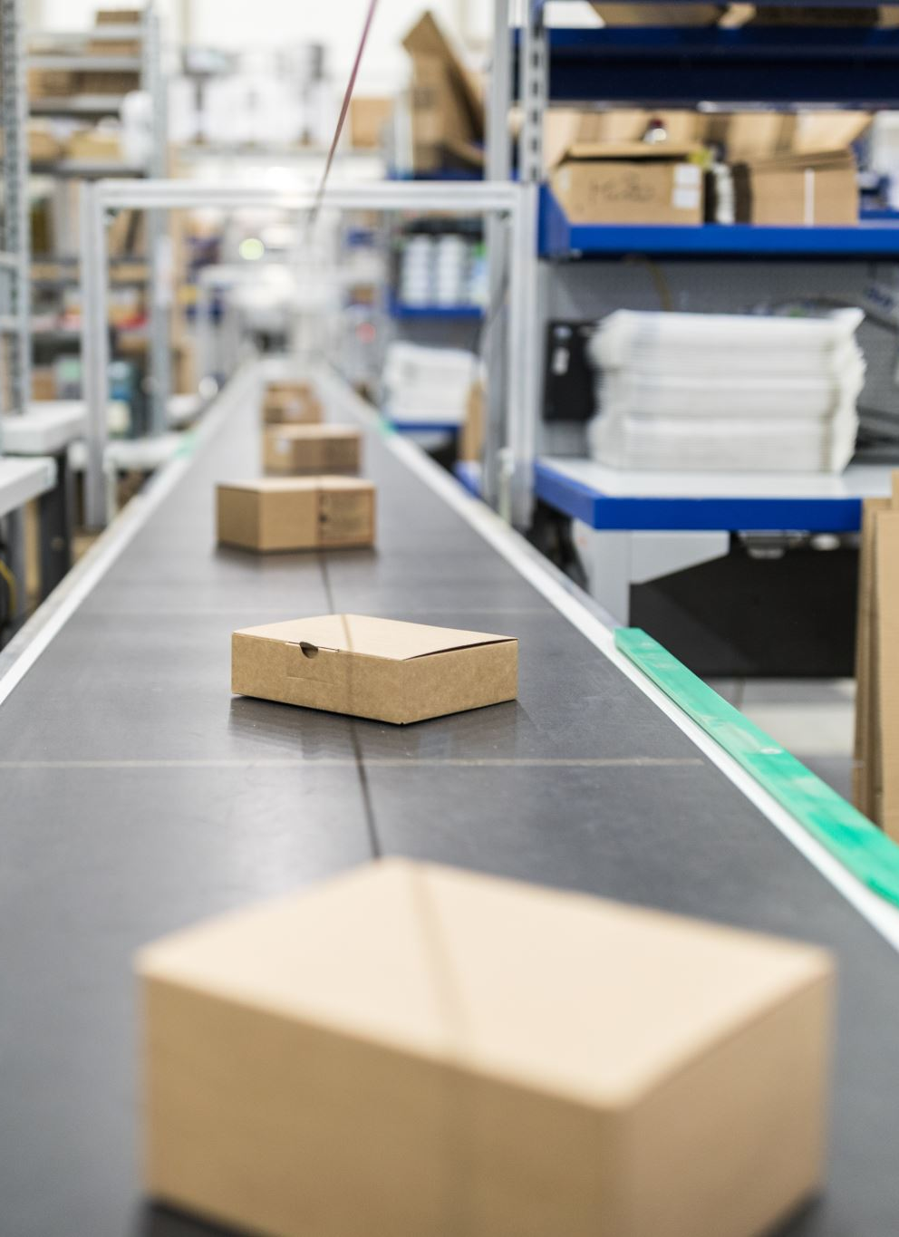
Project goal
We have to built the time series model to predict and forecast the next one year furniture sales of different stores using past values

Slide 3
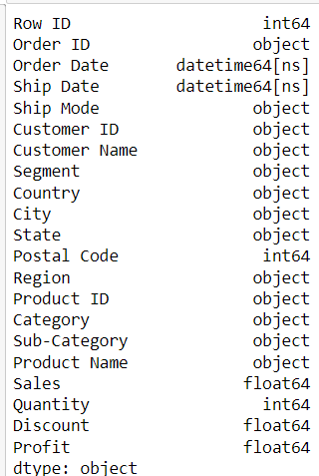
Describe the data and dtypes
The data set contains of 9994 rows and 21 attributes out of which we have to take the furniture category separately to predict the sales of furniture
Finally the data is divided into train and test data sets
Source of data
DS3_C6_S4_TimeSeries_Sales_Data_Project.xls
The dataset is collected from the certain store

Slide 4
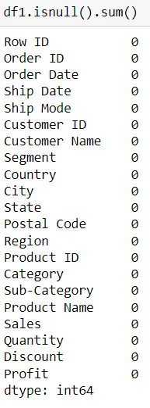
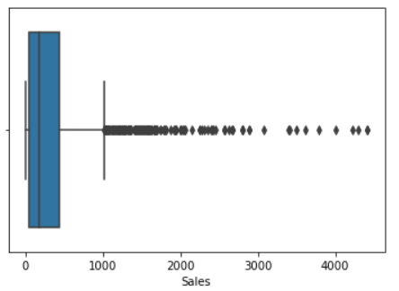
Data preprocessing : Imputation of missing values
Checking for null values
No null values found in the data set
2. Checking for special character
There is no special characters present in the data set
3. Treating outlier
The outliers are observed in the data for predicting the sale at a particular time we have to ignore the outliers

Slide 5
Feature Engineering Techniques
Handling the Missing values.
Converting the date object to datetime format
Set the date as index .
Sort the date in ascending order
Resampling the data weakly for further process
Using hold out method the data is splitted into train test data set

Slide 6
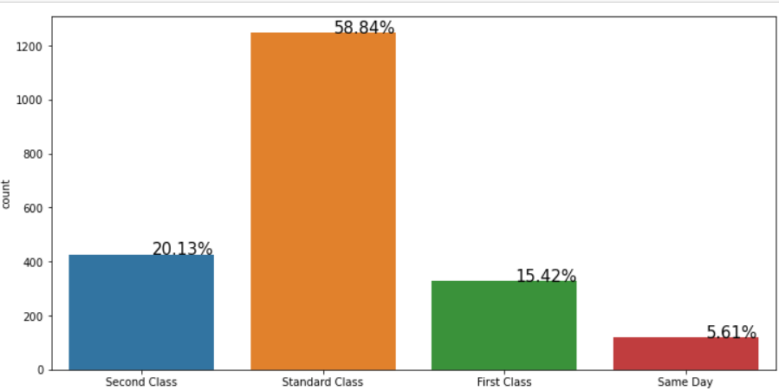
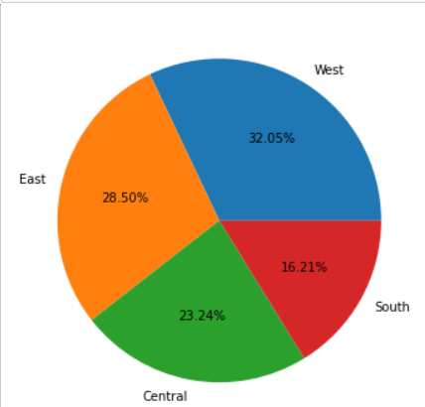
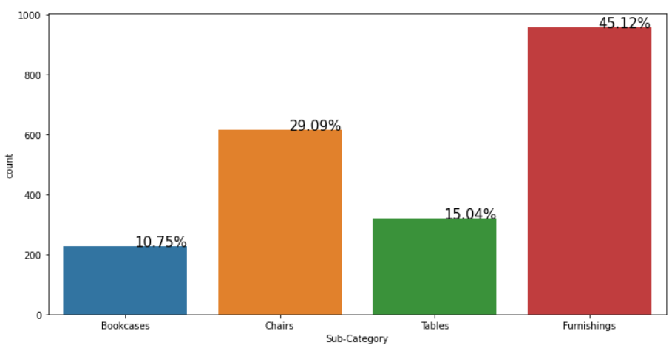
EDA [Exploratory Data Analysis]
the west region is having highest furniture sales of 32.05%
the south region has least sales of 16.21%
the more no of sales are in furnishings subcategory of 45.12%
the least sales are in bookcases with 10.75%
the more no of order placed through standard ship mode with 58.84%
and very least no of orders are placed in same day
the better ship modes are second class and standard class

Slide 7
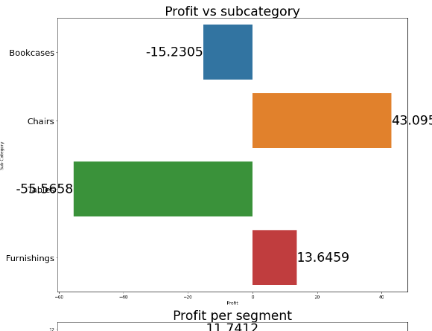
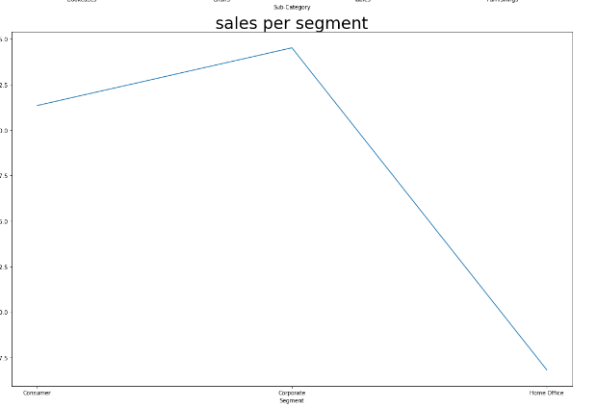
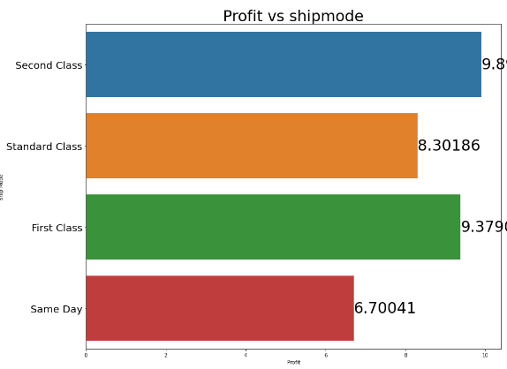
Bivariate Analysis
1. in ship mode the second class has the maximum profit and followed by first class
the least profit in same day
in tables subcategory there is a loss of profit with 55.56 and in bookcase with 15.23
the profit in chairs and furnishings
in the region the maximum profit in south region and loss of profit in central region
in the segment there is no loss but maximum profit is in corporate office

Slide 8
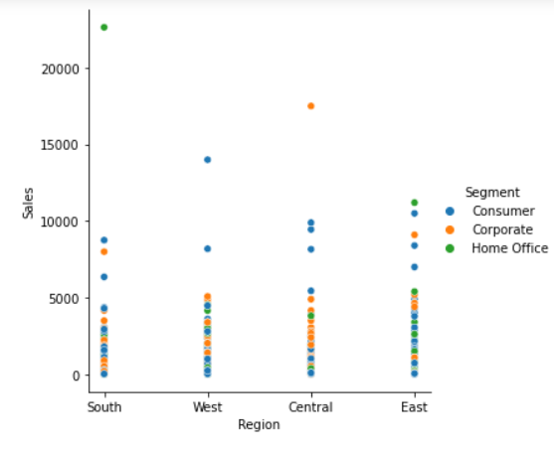
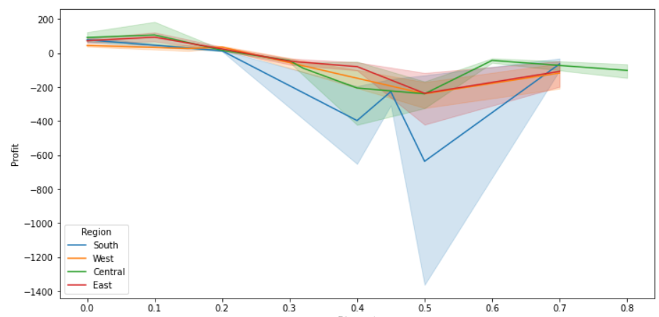
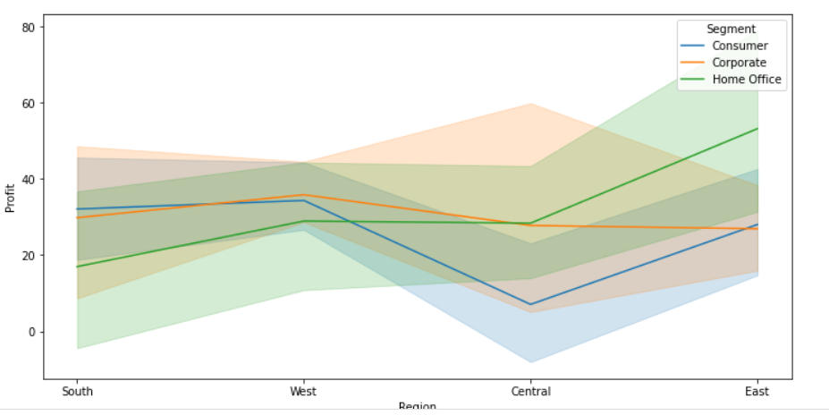
Multivariate Analysis
When the data involves three or more variables, it is categorized under multivariate.
Interpretation from visuals
in technology all the ship mode is giving the profit
in furniture we are getting less profit
in technology the first class giving more profit
In all the region consumer segment has the highest sale
In in central region corporate has the highest sales

Slide 9
Selecting the best model
Algorithms Used
Arma
ARIMA
SARIMA
Used more than one algorithm ?
In this project we used more than one algorithm
First we checked the error values of all three model
After checking the performance of each
We have selected the best one to predict the Sales of Furniture
For predicting the sales I have used Sarima model
The error MSE,RMSE,AIC values of SARIMA model is less compare to other models

Slide 10
Final model
From the above table we can see the performance of all the models
SARIMA is the best model to the Grades of housing
Based on model performances I have selected SARIMA is the best model and I have selected that algorithm to predict the Sales of Furniture
After I have builded the model
Then I have trained the model using train data set
Then I have checked the performance of model id
The minimum Aic valus is 1898.91
Models | MSE | RMSE | AIC | BIC
ARMA | 1950437.84 | 1396.58 | 2782.26 | 2807.21
ARIMA | 1599287.05 | 1264.63 | 2769.12 | 2790.9
SARIMA | 1599287.05 | 1264.63 | 1898.91 | 1907.12

Slide 11
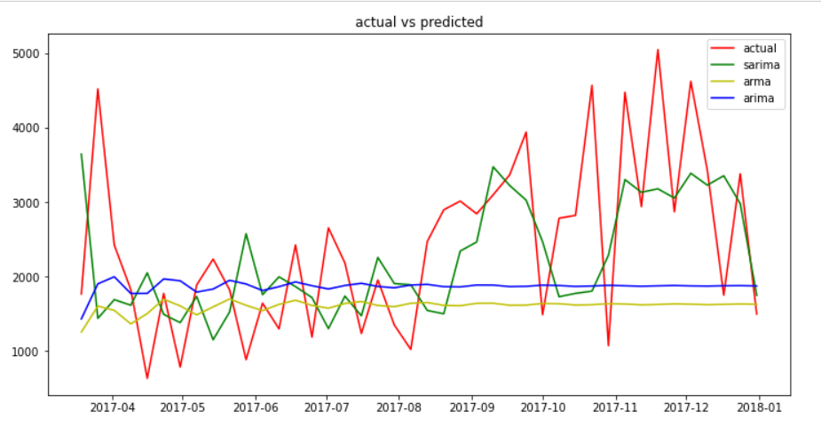
Prediction and Conclusion
Using Sarima have predicted the Sales of Furniture
Conclusion
From the graph we can observe that the red colour trend shows the original data
The blue colour trend line is the predicted sales of the test data

Slide 12
Thank
You

